Slide 1


Deletion and Substitution
It’s deletion and substitution time!
We want to change the beginning, middle, and ending sounds!
We want to make a new word!
Notes:
Deletion and Substitution, 5 minutes
See lesson plan for specific instructional guidance.

Slide 2




Introduce the Sounds
  light
  /l/ /ī/ /t/
  = light
It’s time to learn new sounds!
We use the sound rule to help us read!
Notes:
Introduce the Sounds, 5 minutes
See lesson plan for specific instructional guidance.

Slide 3




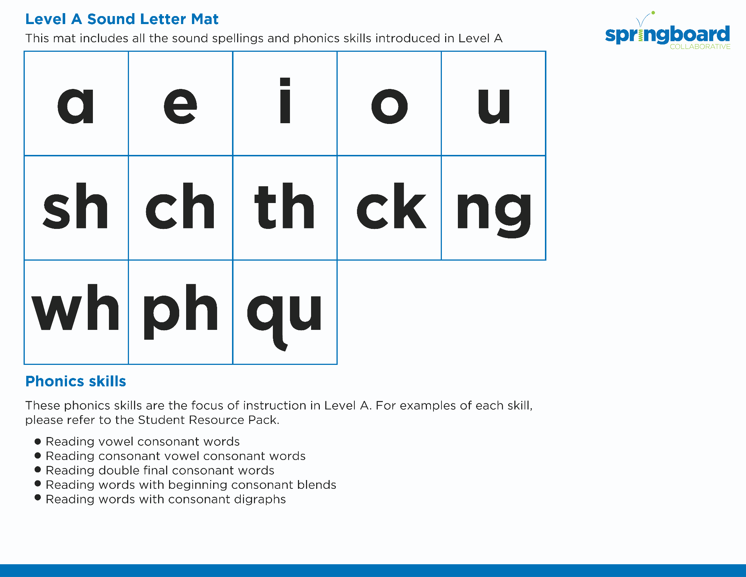
Introduce the Sounds
Notes:
Introduce the Sounds, 5 minutes
See lesson plan for specific instructional guidance.

Slide 4


Blend
the Sounds
high
sight
It’s time to blend the sounds!
It’s time to blend the sounds to help us read the words smoothly!
Notes:
Blend the Sounds, 5 minutes
See lesson plan for specific instructional guidance.

Slide 5


Read
the Words
right
bright
The knight might give me a fright!
It’s time to read the words!
It’s time to read the words, so we can read smoothly, like we are speaking!
Notes:
Read the Words, 5 minutes
See lesson plan for specific instructional guidance.

Slide 6


Decode
the Words
  high sight light right bright night
  thigh flight might
It’s time to decode the sounds in the words!
It’s time to decode the sounds in the words so
we can read the words!
Notes:
Decode the Words, 5 minutes
See lesson plan for specific instructional guidance.

Slide 7


Spell
the Words
t
igh
t
It’s time to spell the words!
It’s time to spell the words to show we understand the rule!
Notes:
Spell the Words, 5 minutes
See lesson plan for specific instructional guidance.

Slide 8
Spell
the Words
n
igh
t
Notes:
Spell the Words, 5 minutes
See lesson plan for specific instructional guidance.

Slide 9

High-
Frequency
Words
great
We see high-frequency words all the time!
Let’s figure out how to read them!
little
Notes:
High-Frequency Words, 5 minutes
See lesson plan for specific instructional guidance.

Slide 10

Decodable Text
  Time to read.
  Let’s use our new rule!
Notes:
Decodable Text, 15 minutes
See lesson plan for specific instructional guidance.

Slide 11
Response to Text
What do firefighters do?
Why are firefighters important to a community?
What are the different ideas the character has for an activity?
Notes:
Response to Text, 10 minutes
See lesson plan for specific instructional guidance.

