Slide 1


Blending and Segmenting
It’s blending and segmenting time!
We want to hear all the sounds
in a word.
We want to hear each sound.
You put the sounds together,
when we blend the word.
We take them apart to segment them.
Notes:
Blending and Segmenting, 5 minutes
See lesson plan for specific instructional guidance.

Slide 2




Introduce the Sounds
  bee
  /b/ /ē/
  = bee
It’s time to learn new sounds!
We use the sound rule to help us read!
Notes:
Introduce the Sounds, 5 minutes
See lesson plan for specific instructional guidance.

Slide 3
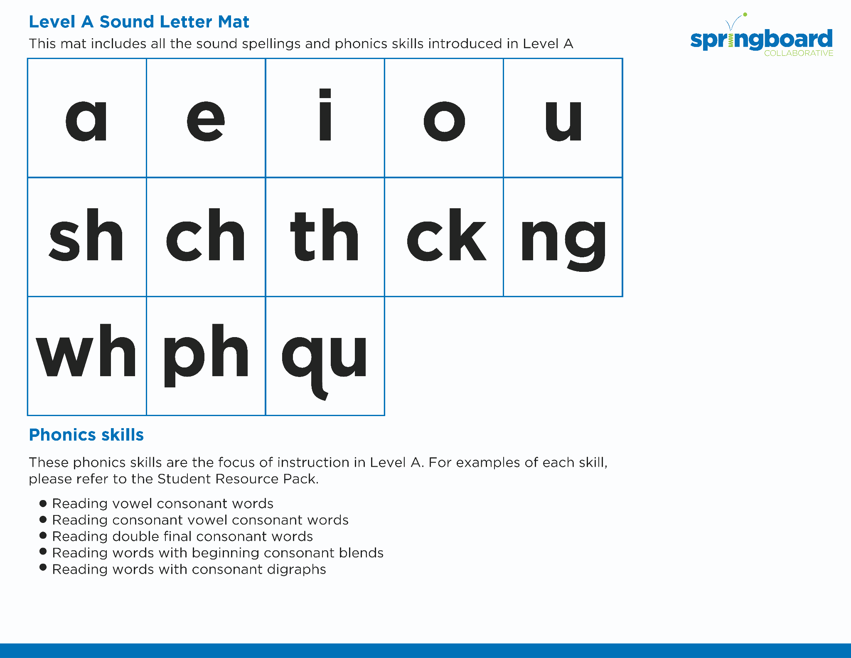


Introduce the Sounds
Notes:
Introduce the Sounds, 5 minutes
See lesson plan for specific instructional guidance.

Slide 4


Blend
the Sounds
tree
feed
It’s time to blend the sounds!
It’s time to blend the sounds to help us read
the words smoothly!
Notes:
Blend the Sounds, 5 minutes
See lesson plan for specific instructional guidance.

Slide 5


Read
the Words
reef
wheel
See the three bees asleep on my feet!
It’s time to read the words!
It’s time to read the words, so we can read smoothly, like we are speaking!
Notes:
Read the Words, 5 minutes
See lesson plan for specific instructional guidance.

Slide 6


Decode
the Words
  seek reef
  creek speed
It’s time to decode the sounds in the words!
It’s time to decode the sounds in the words so we can read the words!
Notes:
Decode the Words, 5 minutes
See lesson plan for specific instructional guidance.

Slide 7


Spell
the Words
h
ee
d
It’s time to spell the words!
It’s time to spell the words to show we understand the rule!
Notes:
Spell the Words, 5 minutes
See lesson plan for specific instructional guidance.

Slide 8
Spell
the Words
h
ee
l
Notes:
Spell the Words, 5 minutes
See lesson plan for specific instructional guidance.

Slide 9

High-
Frequency
Words
work
We see high-frequency words all the time!
Let’s figure out how to read them!
Notes:
High-Frequency Words, 5 minutes
See lesson plan for specific instructional guidance.

Slide 10

Decodable Text
  Time to read.
  Let’s use our new rule!
Notes:
Decodable Text, 15 minutes
See lesson plan for specific instructional guidance.

Slide 11
What does Mr. Chen’s class wish for?
What does the class say kids can do with books if they get their wish?
Why are James and his family glad that the plane is late?
What do you think will happen next at the end of the story?
Response to Text
Notes:
Response to Text, 10 minutes
See lesson plan for specific instructional guidance.

