Slide 1




Introduce the sounds
  tail
  /t/ /ā/ /l/ = tail
It’s time to learn new sounds!
We use the sound rule to help us read!
Notes:
See lesson plan for specific instructional guidance.
Introduce the Sound!
Say: Learning new sounds is so cool! Repeat our chant after me!
"It's time to learn new sounds!
We use the sound rule to help us read!"
Do: Say one sentence at a time of the Introduce the Sound chant and ask the students to repeat after you.
Say: Let's learn a super cool new rule today!
Say: Remember, in this unit, we're learning all about the long vowel sounds and what spelling patterns we use to make the long vowel sound. We learned that you can make a long a from an open syllable or from a bossy e. You can also make a long a sound using the spelling pattern, ai. For example, tail has an a-i spelling pattern and makes the long vowel sound /a/, so we read the word /t/ /a/ /l/ = tail.
Do: Show the Sound Letter card ai.
Say: A-i says /a/, the long vowel sound for a.

Slide 2
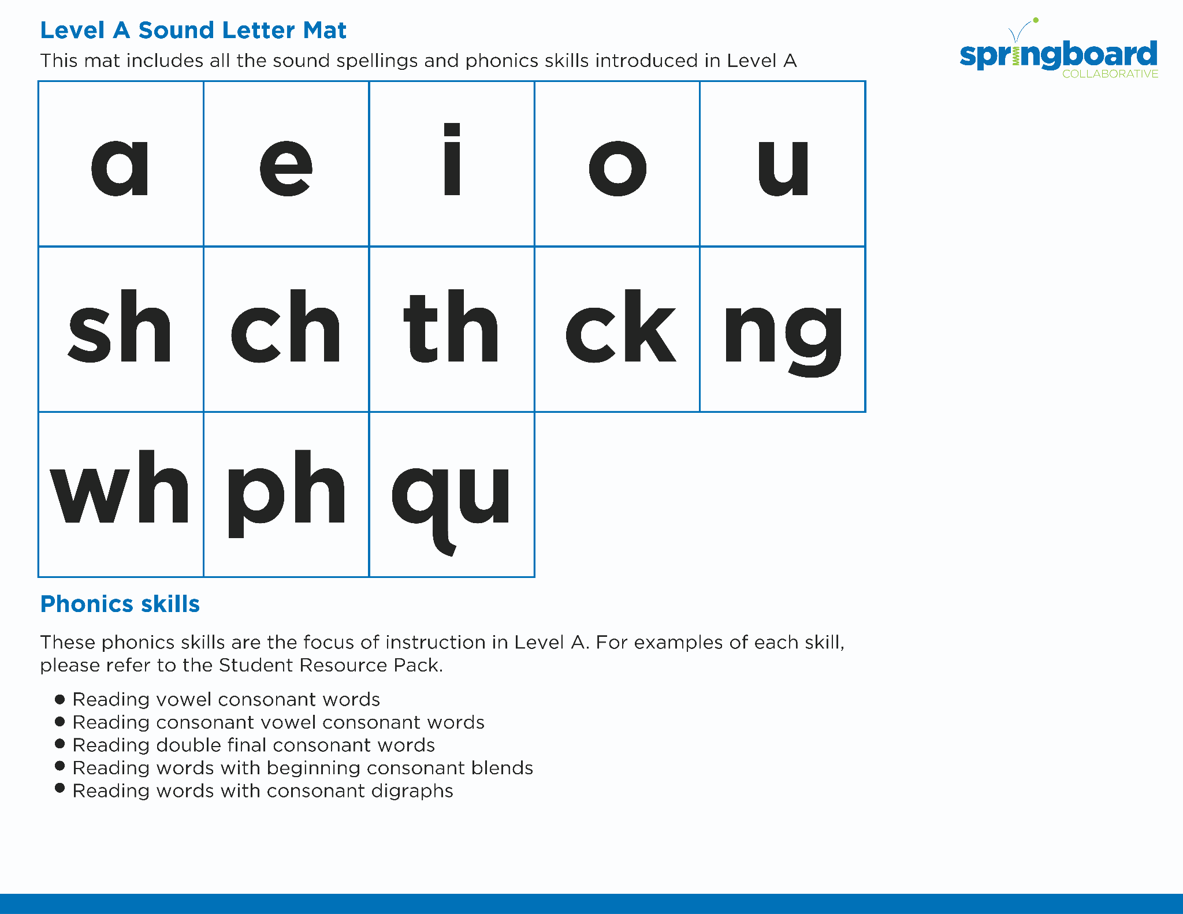
Introduce the sounds
Notes:
See lesson plan for specific instructional guidance.
Introduce the Sound!
Say: Let's review all our sound letter cards including our new card, a-i.
Do: Flip through and review all the sound spelling cards students have learned so far including the new card from today. (Sound Letter Cards: a, e, i, o, u, wh, sh, ch, ng, ck, ph, qu)
Say: Let's practice reading our new word pattern!

Slide 3



Blend
the sounds
tail
Family Activity
snail
It’s time to blend the sounds!
It’s time to blend the sounds to help us read the words smoothly!
Notes:
See lesson plan for specific instructional guidance.
Blend the Sounds!
Say: Blending sounds helps us read the words smoothly! Repeat our chant after me!
"It's time to blend the sounds!
It's time to blend the sounds to help us read the words smoothly!"
Do: Say one sentence at a time of the Blend the Sounds chant and ask the students to repeat after you.
Say: Let's practice blending the sounds in some words today!
Say: When we blend the sounds in words, it helps us read the words smoothly. Let's try it. The letters a-i together say /a/.
Do: Point to the word tail.
Say: This word begins with a consonant, t. T says /t/. I notice that the next two letters are a-i. Underline this vowel pair to help us remember that a-i stay together. A-i says /a/. Next is a consonant l. L says /l/. The words says /t/ /a/ /l/ = "tail". Let's segment and blend the word together now using our Double Decker Elkonin Boxes.
Do: Segment and blend the word tail using the Double Decker Elkonin Boxes.
Say: Why is this word read as /t/ /a/ /l/ = "tail"?
Do: Listen as students explain the sound spelling pattern a-i.
Say: Smart explanations! Let's look at another word.
Do: Point to the word snail.
Say: This word begins with a consonant blend, /s/ /n/. s-n says /s/ /n/. Next comes a vowel pair, a-i. Underline our vowel pair a-i to remind us that these letters stay together to make one sound. What happens when we have this spelling pattern?
Do: Listen as students explain that a-i says /a/.
Say: Yes! A-i says /a/. We have /s/ /n/ /a/ and the consonant /l/. The word is /s/ /n/ /a/ /l/ = "snail". Blend using your Double Decker Elkonin Boxes.
Do: Listen as students blend the word. Take notes on the students that can accurately blend the open syllable using the long vowel sound and students that may need reteaching and/or additional support.
Say: A-i says /a/. Great thinking while blending the sounds today!

Slide 4


Read
the words
Family Activity
main
chain
It’s time to read the words!
It’s time to read the words so we can read smoothly like we are speaking!
Does a snail have a tail or a waist?
Notes:
See lesson plan for specific instructional guidance.
Read the Words!
Say: When we practice reading the words, it can help us read the words faster and faster. This helps us learn to read smoothly like when we are speaking! Repeat our chant after me!
"It's time to read the words!
It's time to read the words so we can read smoothly like we are speaking!"
Do: Say one sentence at a time of the Read the Words chant and ask the students to repeat after you.
Say: Let's practice reading words today!
Say: We are going to read the words. When we practice reading the words, it helps us read faster and faster. This helps us focus on what we can learn from the words. Let's look at the first word.
Do: Point to the word main.
Say: When we read this word, we look to see what spelling pattern it uses so we know what vowel sound to make. I see a consonant, a-i, consonant. Underline the a-i to remind us that this vowel pair sticks together. We'll use the long vowel sound. /m/ /a/ /n/ = main. Your turn using the Double Decker Elkonin Boxes.
Do: Listen as students read the word. Take notes on the students that can accurately articulate the sounds and read the word, and students that may need reteaching and/or additional support.
Say: Yes, the word is "main". Let's look at the next word. How would you read this word?
Do: Point to the word chain.
Say: Look at this spelling pattern! I see a consonant digraph, vowel pair, consonant. Underline the consonant digraph c-h and the vowel pair a-i because these letters stick together! How will you read this word?
Do: Listen as students read the word. Take notes on the students that can accurately articulate the sound and read the word, and students that may need reteaching and/or additional support.
Say: Yes, the word is "chain".
Do: Display the sentence: Does a snail have a tail or a waist?
Say: Take a couple minutes to read this sentence with your partner. All of the words follow rules you've learned or are High Frequency Words you've learned. Raise your hands when you have the whole sentence read and I'll come listen. You can do it!
Do: Monitor and assist. You may support by asking students to recognize the spelling pattern, prompting students to use the long or short vowel sound, asking students to underline letters that stick together, etc.
Say: I'll read it aloud as you read it with me.
Do: Read sentence.
Say: Amazing work! Remember, a-i says a. Those brains are growing!

Slide 5


Decode
the words
  wait paint
  faint waist
It’s time to decode the sounds in the words!
It’s time to decode the sounds in the words so
we can read the words!
Notes:
See lesson plan for specific instructional guidance.
Decode the Words!
Say: Decoding is when you break up the sounds in a word and read each sound one at a time. Then you blend the sounds together to read the word! Repeat our chant after me!
"It's time to decode the sounds in the words!
It's time to decode the sounds in the words so we can read the words!"
Do: Say one sentence at a time of the Decode the Words chant and ask the students to repeat after you.
Say: Let's practice decoding the sounds in words today!
Say: We are going to decode the words. Remember, decoding is when you break up the sounds in a word and read each sound one at a time. Then you blend the sounds together to read the word! When we decode the sounds in words, it helps us read the words correctly. Look at our words for today.
Do: Point to the words.
Say: First, look at the spelling pattern to decide what vowel sound to use. Next, say each sound. Finally, blend the sounds together to read the words.
Do: Partner students.
Say: You and your partner work together to decode these words (wait, paint, faint, waist). I'll be by to listen. Use your Double Decker Elkonin Boxes.
Do: Listen as students decode the word. Take notes on the students that can accurately articulate the sounds and read the word, and students that may need reteaching and/or additional support.
Say: Excellent work applying our new rule to decoding words today!

Slide 6


Spell
the words
w
ai
n
It’s time to spell the words!
It’s time to spell the words to show we understand the rule!
Notes:
See lesson plan for specific instructional guidance.
Spell the Words!
Say: When we can spell words, it shows that we met the target. When we hear the sounds, we can match the sounds to the correct letters and spell the word! Repeat our chant after me!
"It's time to spell the words!
It's time to spell the words to show we understand the rule!"
Do: Say one sentence at a time of the Spell the Words chant and ask the students to repeat after you.
Say: Let's practice spelling words today!
Say: We are going to spell the words. Remember, when we can spell words with the correct rule, it shows that we met the target. When we hear the sounds, we can match the sounds to the correct letters and spell the word! Listen to our words for today. The word is wain. How would we spell the word wain? Let's listen to the sounds and match the sound to the correct letter. The word is "wain". I hear /w/ /a/ /n/. I know that sound for /w/ = w and the sound for /a/ can be spelled with a bossy final e or ai. Let's spell it with ai. I hear a /n/ sound at the end. Grab your whiteboards and write the word.
Do: Watch as students spell the word using the letter and sound connections. Take notes on the students that can accurately articulate the sound and spell the word, and students that may need reteaching and/or additional support.
Say: Yes, when we spell the word wain we write the letters w-a-i-n.

Slide 7
Spell
the words
p
n
ai
Notes:
See lesson plan for specific instructional guidance.
Spell the Words!
Say: Now I want to make a new word by changing the beginning consonant sound. What would the word be if we changed the /w/ sound in wain, to the /p/ sound? /p/ /a/ /n/. Grab your whiteboards and write the word.
Do: Watch as students spell the word using the letter and sound connections. Take notes on the students that can accurately articulate the sound and spell the word, and students that may need reteaching and/or additional support.
Say: Yes, when we change the beginning sound from /w/ in wain to /p/ we write the letters make for the word "pain". We use a-i for the long vowel sound. Great thinking! Awesome job spelling words today!

Slide 8
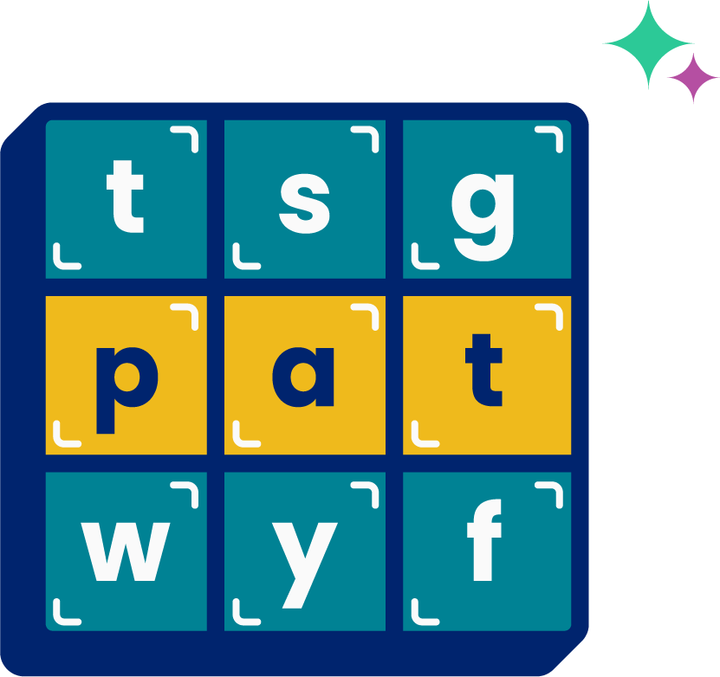
High
Frequency
Words
Family Activity
very
We see high frequency words all the time!
Let’s figure out how to read them!
Notes:
See lesson plan for specific instructional guidance.
High Frequency Words!
Say: Some words we can sound out now, some words we'll learn how to sound out later, and some words are rule breakers and we can't sound out. Words that show up a lot in books are called High Frequency Words. Let's learn some! Repeat our chant after me!
"We see high frequency words all the time!
Let's figure out how to read them!"
Do: Say one sentence at a time of the High Frequency Words chant and ask the students to repeat after you.
Say: Let's read our high frequency words!
Say: Today, we're learning 1 new word.
Do: Display the word very.
Say: This word uses an unusual sound for the e. It begins with a consonant /v/ spelled v. The e says /a/. The r says /r/ and the y says /e/. Read this word with me. /v/ /a/ /r/ /e/.
Do: Listen to responses.
Say: Yes! "very". I am very proud of you. Very. Read it again.
Do: Point to words and listen to students read.
Say: Excellent! Let's read our previous high frequency words!
Do: Point to or hold up all the high frequency words to this point as the students read them.
Say: Excellent work learning 1 new high frequency word today.
very

