Slide 1
Introduce the sounds
CCVC
Words
scan
/s/ /c/ /ă/ /n/ = scan
It’s time to learn new sounds!
We use the sound rule to help us read!
Notes:
See lesson plan for specific instructional guidance.
Introduce the Sound!
Say: Learning new sounds is so cool! Repeat our chant after me!
"It's time to learn new sounds!
We use the sound rule to help us read!"
Do: Say one sentence at a time of the Introduce the Sound chant and ask the students to repeat after you.
Say: Let's learn a super cool new rule today!
Say: We'll be exploring consonant consonant vowel consonant (CCVC) words that use a consonant blend. Remember, a consonant blend is when two consonants are side by side. When you read them, you hear both of their sounds blend in the word. Today we'll be decoding words that have a "s blend". Words in this unit will begin with two consonants, then have a vowel, and finish with a consonant. When we read CCVC words, we use the short vowel sound. For example, scan is a CCVC word with a consonant blend, so we read the word /s/ /k/ /a/ /n/ = scan. Let's review the short sounds of the vowels.
Do: Show the a, e, i, o, u sound letter cards and review the sounds.
Say: Let's practice reading our CCVC words!

Slide 2
Blend
the sounds
snap
Family Activity
stop
It’s time to blend the sounds!
It’s time to blend the sounds to help us read
the words smoothly!
Notes:
See lesson plan for specific instructional guidance.
Blend the Sounds!
Say: Blending sounds helps us read the words smoothly! Repeat our chant after me!
"It's time to blend the sounds!
It's time to blend the sounds to help us read the words smoothly!"
Do: Say one sentence at a time of the Blend the Sounds chant and ask the students to repeat after you.
Say: Let's practice blending the sounds in some words today!
Say: When we blend the sounds in words, it helps us read the words smoothly. Let's try it. A consonant blend is when you have 2 consonants next to one another in a word. When this happens, you make the sound of each consonant when reading the word. Let me give you an example.
Do: Point to the word snap.
Say: This word begins with 2 consonants, s-n. Next comes a vowel, a. It ends with another consonant, p. This is a CCVC word or closed syllable, because it ends with a consonant. Because it's a CCVC word, or a closed consonant, I know that I will use the short vowel sound for a, /a/. Now that I know what kind of word it is, and what vowel sound to use, I can blend the sounds together to read the word. Remember, when reading a word with a consonant blend, we say the sounds of both consonants. /s/ /n/ /a/ /p/ = snap. Let's segment and blend the word together now. Use your Double Decker Elkonin Boxes.
Do: Segment and blend the word snap.
Say: Let's look at another word.
Do: Point to the word stop.
Say: This word begins with 2 consonants, /s/ and /t/. Next comes a vowel, o. It ends with another consonant, p. This is a CCVC word and a closed syllable, because it ends with a consonant. Because it's a CCVC word, or a closed consonant, I know that I will use the short vowel sound for o, /o/. Remember, when reading a word with a consonant blend, we say the sounds of both consonants. Now that I know what kind of word it is, and what vowel sound to use, I can blend the sounds together to read the word. /s/ /t/ /o/ /p/ = stop. Let's blend it together now. Use your Double Decker Elkonin Boxes.
Do: Listen as students blend the word. Take notes on the students that can accurately blend the CCVC word and students that may need reteaching and/or additional support.
Say: Great thinking! Awesome job blending the sounds today!

Slide 3
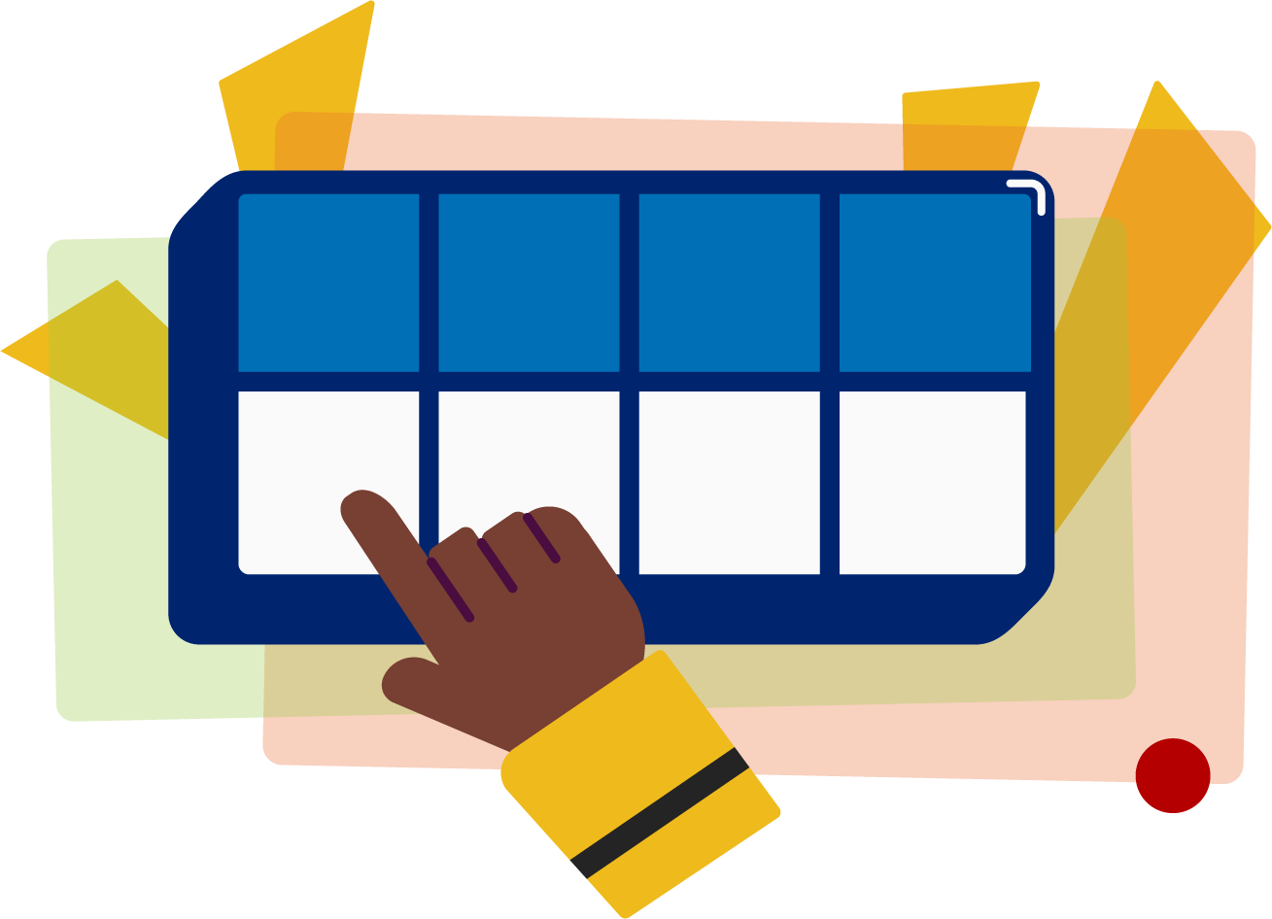
Read
the words
Family Activity
skid
slop
It’s time to read the words!
It’s time to read the words, so we can read smoothly, like we are speaking!
step
Notes:
See lesson plan for specific instructional guidance.
Read the Words!
Say: When we practice reading the words, it can help us read the words faster and faster. This helps us learn to read smoothly like when we are speaking! Repeat our chant after me!
"It's time to read the words!
It's time to read the words, so we can read smoothly, like we are speaking!"
Do: Say one sentence at a time of the Read the Words chant and ask the students to repeat after you.
Say: Let's practice reading words today!
Say: We are going to read the words. When we practice reading the words, it helps us read faster and faster. This helps us focus on what we can learn from the words. Let's look at the first word.
Do: Point to the word skid.
Say: When we read this word, we look to see what spelling pattern it uses so we know what vowel sound to make. I see a CCVC spelling pattern. We'll use the short vowel sound. Remember, when reading a word with a consonant blend, we say the sounds of both consonants. /s/ /k/ /i/ /d/ = skid. Your turn. Use your Double Decker Elkonin Boxes.
Do: Listen as students read the word. Take notes on the students that can accurately articulate the sounds and read the word and students that may need reteaching and/or additional support.
Say: Yes, the word is skid. Let's look at the next word. How would you read this word? Use your Double Decker Elkonin Boxes.
Do: Point to the word slop. Listen as students read the word. Take notes on the students that can accurately articulate the sound and read the word and students that may need reteaching and/or additional support.
Say: Yes, the word is slop. One more.
Do: Point to the word step. Listen as students read the word. Take notes on the students that can accurately articulate the sound and read the word and students that may need reteaching and/or additional support.
Say: Great thinking! Awesome job reading the words today!

Slide 4
Decode
the words
stun sped
span swam
It’s time to decode the sounds in the words!
It’s time to decode the sounds in the words so we can read the words!
Notes:
See lesson plan for specific instructional guidance.
Decode the Words!
Say: Decoding is when you break up the sounds in a word and read each sound one at a time. Then you blend the sounds together to read the word! Repeat our chant after me!
"It's time to decode the sounds in the words!
It's time to decode the sounds in the words so we can read the words!"
Do: Say one sentence at a time of the Decode the Words chant and ask the students to repeat after you.
Say: Let's practice decoding the sounds in words today!
Say: We are going to decode the words. Remember, decoding is when you break up the sounds in a word and read each sound one at a time. Then you blend the sounds together to read the word! When we decode the sounds in words, it helps us read the words correctly. Look at our words for today.
Do: Point to the words.
Say: First, look at the spelling pattern to decide what vowel sound to use. Next, say each sound. Finally, blend the sounds together to read the words.
Do: Partner students.
Say: You and your partner work together to decode these words (stun, sped, span, swam). I'll be by to listen. Use your Double Decker Elkonin Boxes.
Do: Listen as students decode the word. Take notes on the students that can accurately articulate the sounds and read the word and students that may need reteaching and/or additional support.
Say: Great thinking! Awesome job decoding words today!

Slide 5
Spell
the words
p
s
k
i
It’s time to spell the words!
It’s time to spell the words to show we understand the rule!
Notes:
See lesson plan for specific instructional guidance.
Spell the Words!
Say: When we can spell words, it shows that we met the target. When we hear the sounds, we can match the sounds to the correct letters and spell the word! Repeat our chant after me!
"It's time to spell the words!
It's time to spell the words to show we understand the rule!"
Do: Say one sentence at a time of the Spell the Words chant and ask the students to repeat after you.
Say: Let's practice spelling words today!
Say: We are going to spell the words. Remember, when we can spell words with the correct rule, it shows that we met the target. When we hear the sounds, we can match the sounds to the correct letters and spell the word! Listen to our words for today. The word is skip. How would we spell the word skip? Let's listen to the sounds and match the sound to the correct letter. The word is "skip". I hear /s/ /k/ /i/ /p/ and I know that sound for /s/ = the letter s and the sound for /k/ = the letter k, and the sound for /i/ is the letter i, and the sound for /p/ is the letter p. We spell /s /k/ /i/ /p/ = s-k-i-p. Grab your whiteboard to write.
Do: Watch as students spell the word using the letter and sound connections. Take notes on the students that can accurately articulate the sound and spell the word and students that may need reteaching and/or additional support.
Say: Yes, when we spell the word skip we write the letters s-k-i-p.

Slide 6
Spell
the words
s
k
i
m
Notes:
See lesson plan for specific instructional guidance.
Spell the Words!
Say: Now I want to make a new word by changing the ending sound. What would the word be if we changed the /p/ sound in skip, to the /m/ sound? /s/ /k/ /i/ /m/. Grab your whiteboard to write.
Do: Watch as students spell the word using the letter and sound connections. Take notes on the students that can accurately articulate the sound and spell the word and students that may need reteaching and/or additional support.
Say: Yes, when we change the ending sound from /p/ in skip to /m/, we write the letters s-k-i-m for the word skim.

Slide 7
Spell
the words
s
k
i
d
Notes:
See lesson plan for specific instructional guidance.
Spell the Words!
Say: What about if we want to change the word to skid? How would we change the final consonant? Grab your whiteboard to write.
Do: Listen as students explain to change the final consonant from /m/ to /d/ to make /s/ /k/ /i/ /d/ spelled s-k-i-d.
Say: Great thinking! Awesome job spelling words today!

Slide 8
High
Frequency
Words
Family Activity
to
We see high frequency words all the time!
Let’s figure out how to read them!
two
Notes:
See lesson plan for specific instructional guidance.
High Frequency Words!
Say: Some words we can sound out now, some words we'll learn how to sound out later, and some words are rule breakers and we can't sound out. Words that show up a lot in books are called High Frequency Words. Let's learn some! Repeat our chant after me!
"We see high frequency words all the time!
Let's figure out how to read them!"
Do: Say one sentence at a time of the High Frequency Words chant and ask the students to repeat after you.
Say: Let's read our high frequency words!
Say: Today, we're learning 1 new word that isn't pronounced how you think it is.
Do: Display the word two and the word to.
Say: Remember this high frequency word, "to". Well, you're never going to believe it, but this word t-w-o, is read exactly the same way. These words are called homophones because they sound the same even though they're spelled differently and mean different thing. T-o is used like "I'm going to school." T-w-o is used like "I have two hands." It's the spelling for the number 2. Let's read both these words. Use your Double Decker Elkonin Boxes.
Do: Segment "to" into /t/ /oo/ and "two" into /t/ /oo/. Students move a manipulative on their Double Decker Elkonin Boxes as they segment and blend.
Say: Yes! Read it again.
Do: Listen to responses.
Say: Excellent! Let's use our Double Decker Elkonin Boxes to read a couple of these words that have been tricky for us.
Do: Choose a few HFW that have been challenging to practice and have students use their Double Decker Elkonin Boxes as they read the words.
Say: Excellent work learning 1 new high frequency word and practicing old words today.
two

