Slide 1
Introduce the sounds
CVC
Words
cat
/k/ /ă/ /t/ = cat
It’s time to learn new sounds!
We use the sound rule to help us read!
saw
Notes:
See lesson plan for specific instructional guidance.
Introduce the Sound!
Say: Learning new sounds is so cool! Repeat our chant after me!
"It's time to learn new sounds!
We use the sound rule to help us read!"
Do: Say one sentence at a time of the Introduce the Sound chant and ask the students to repeat after you.
Say: Let's learn a super cool new rule today!
Say: Let's continue reading CVC words today. All the words today will use the vowel a.
Say: Remember that letters are either a vowel (a, e, i, o, u) or a consonant (other letters). Knowing the difference between a vowel and consonant can help you decode words and read them. Let's sing our Alphabet Song using our Letter Mat. Then, we'll go back and point out the vowels and consonants.
Do: Sing the Alphabet Song sound pointing to the consonants and vowels. Listen as students identify the letters. Take notes on the students that can accurately name consonants and vowels and students that may need reteaching and/or additional support.
Say: When we read CVC words, we use the short vowel sound. For example, cat is a CVC word, so we read the word /k/ /a/ /t/ = cat. Let's quickly review the short vowel sounds.
Do: Show the letter a sound letter card.
Say: The short sound of A is /a/ like apple. What is the short sound of a?
Do: Listen and correct if necessary.
Say: When we read CVC words, or closed syllables, we use the short vowel sound. We will explore how to read CVC words with the vowel a during this lesson.

Slide 2
Blend the sounds
rat
Family Activity
yap
It’s time to blend the sounds!
It’s time to blend the sounds to help us read the words smoothly!
Notes:
See lesson plan for specific instructional guidance.
Blend the Sounds!
Say: Blending sounds helps us read the words smoothly! Repeat our chant after me!
"It's time to blend the sounds!
It's time to blend the sounds to help us read the words smoothly!"
Do: Say one sentence at a time of the Blend the Sounds chant and ask the students to repeat after you.
Say: Let's practice blending the sounds in some words today!
Say: When we blend the sounds in words, it helps us read the words smoothly. Let's try it.
Do: Look at our CVC words for today.
Say: Let's look at this word.
Do: Point to the word rat.
Say: This word begins with a consonant, r. Next comes a vowel, a. It ends with another consonant, t. This is a CVC word or closed syllable, because it ends with a consonant. Because it's a CVC word, or a closed consonant, I know that I will use the short vowel sound for a, /a/. Now that I know what kind of word it is, and what vowel sound to use, I can blend the sounds together to read the word. /r/ /a/ /t/ = rat. Let's blend it together now.
Do: Listen as the students blend the word.
Say: Let's look at another word.
Do: Point to the word yap.
Say: This word begins with a consonant, y. Next comes a vowel, a. It ends with another consonant, p. This is a CVC word or closed syllable, because it ends with a consonant. Because it's a CVC word, or a closed consonant, I know that I will use the short vowel sound for a, /a/. Now that I know what kind of word it is, and what vowel sound to use, I can blend the sounds together to read the word. /y/ /a/ /p/ = yap. Let's blend it together now.
Do: Listen as students blend the word. Take notes on the students that can accurately blend the CVC word and students that may need reteaching and/or additional support.
Say: Great thinking! Awesome job blending the sounds today!

Slide 3
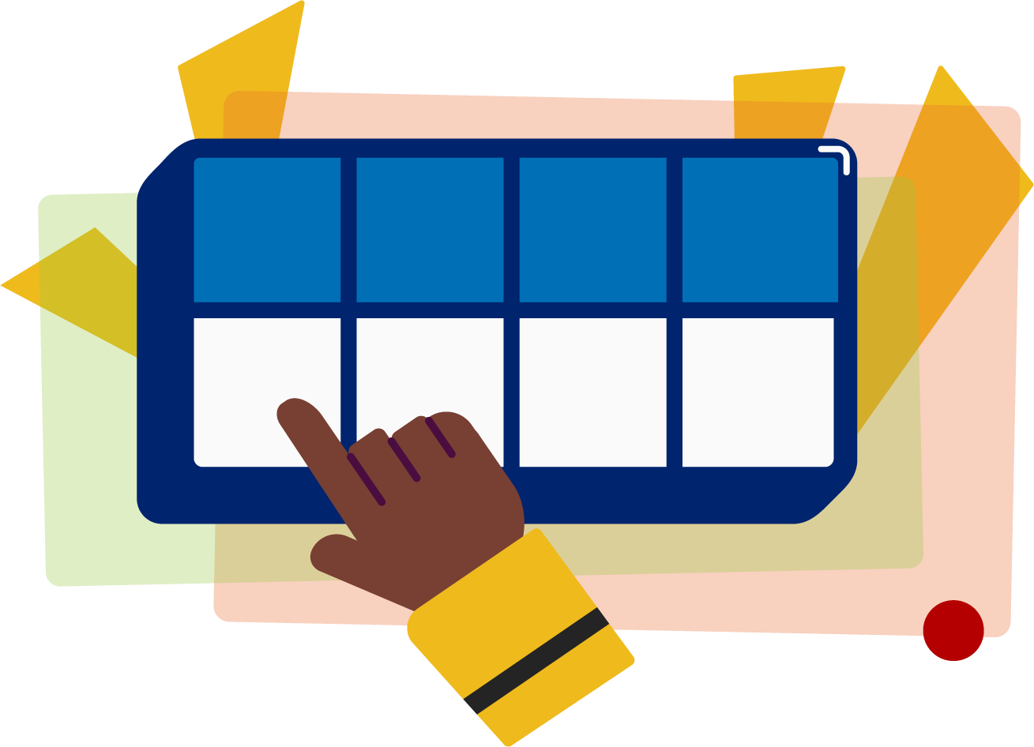
Read the words
Family Activity
gal
tan
It’s time to read the words!
It’s time to read the words, so we can read smoothly, like we are speaking!
tax
Notes:
See lesson plan for specific instructional guidance.
Read the Words!
Say: When we practice reading the words, it can help us read the words faster and faster. This helps us learn to read smoothly like when we are speaking! Repeat our chant after me!
"It's time to read the words!
It's time to read the words, so we can read smoothly, like we are speaking!"
Do: Say one sentence at a time of the Read the Words chant and ask the students to repeat after you.
Say: Let's practice reading words today!
Say: We are going to read the words. When we practice reading the words, it helps us read faster and faster. This helps us focus on what we can learn from the words. Let's look at the first word.
Do: Point to the word gal.
Say: When we read this word, we look to see what spelling pattern it uses so we know what vowel sound to make. I see a CVC closed syllable pattern. We'll use the short vowel sound. /g/ /a/ /l/ = gal.
Do: Model decoding the word as you push an object up in Double Decker Elkonin Boxes.
Say: Do it with me. Your turn.
Do: Listen as students read the word. Take notes on the students that can accurately articulate the sounds and read the word and students that may need reteaching and/or additional support.
Say: Yes, the word is "gal". Let's look at the next word. How would you read this word?
Do: Point to the word tan. Listen as students read the word. Take notes on the students that can accurately articulate the sound and read the word and students that may need reteaching and/or additional support.
Say: Yes, the word is "tan". One more.
Do: Point to the word tax. Listen as students read the word. Take notes on the students that can accurately articulate the sound and read the word and students that may need reteaching and/or additional support.
Say: Great thinking! Awesome job reading the words today!

Slide 4
Decode the words
tab sat
rag gap
jam
It’s time to decode the sounds in the words!
It’s time to decode the sounds in the words so we can read the words!
Notes:
See lesson plan for specific instructional guidance.
Decode the Words!
Say: Decoding is when you break up the sounds in a word and read each sound one at a time. Then you blend the sounds together to read the word! Repeat our chant after me!
"It's time to decode the sounds in the words!
It's time to decode the sounds in the words so we can read the words!"
Do: Say one sentence at a time of the Decode the Words chant and ask the students to repeat after you.
Say: Let's practice decoding the sounds in words today!
Say: We are going to decode the words. Remember, decoding is when you break up the sounds in a word and read each sound one at a time. Then you blend the sounds together to read the word! When we decode the sounds in words, it helps us read the words correctly.
Say: Look at our words for today.
Do: Point to the words.
Say: First, look at the spelling pattern to decide what vowel sound to use. Next, say each sound. Finally, blend the sounds together to read the words.
Do: Partner students.
Say: You and your partner work together to decode these words (tab, sat, rag, gap, jam). I'll be by to listen.
Do: Listen as students decode the word. Take notes on the students that can accurately articulate the sounds and read the word and students that may need reteaching and/or additional support.
Say: Great thinking! Awesome job decoding words today!

Slide 5
Spell the words
w
a
g
It’s time to spell the words!
It’s time to spell the words to show we understand the rule!
Notes:
See lesson plan for specific instructional guidance.
Spell the Words!
Say: When we can spell words, it shows that we met the target. When we hear the sounds, we can match the sounds to the correct letters and spell the word! Repeat our chant after me!
"It's time to spell the words!
It's time to spell the words to show we understand the rule!"
Do: Say one sentence at a time of the Spell the Words chant and ask the students to repeat after you.
Say: Let's practice spelling words today!
Say: We are going to spell the words. Remember, when we can spell words with the correct rule, it shows that we met the target. When we hear the sounds, we can match the sounds to the correct letters and spell the word! Listen to our words for today. The word is wag. How would we spell the word wag? Let's listen to the sounds and match the sound to the correct letter. The word is "wag". I hear /w/ /a/ /g/ and I know that sound for /w/ = the letter w and the sound for /a/ = the letter a, and the sound for /g/ is the letter g so I know it is spelled with the letters w-a-g. Grab your whiteboards and spell the word.
Do: Watch as students spell the word using the letter and sound connections. Take notes on the students that can accurately articulate the sound and spell the word and students that may need reteaching and/or additional support.
Say: Yes, when we spell the word wag, we write the letters w-a-g.

Slide 6
Spell the words
d
a
d
Notes:
See lesson plan for specific instructional guidance.
Spell the Words!
Say: The word is dad. How would you spell this word?
Do: Watch as students spell the word using the letter and sound connections. Take notes on the students that can accurately articulate the sound and spell the word and students that may need reteaching and/or additional support.
Say: Yes, when we spell the word dad, we write the letters d-a-d.

Slide 7
Spell the words
p
a
t
Notes:
See lesson plan for specific instructional guidance.
Spell the Words!
Say: One more, pat.
Do: Watch as students spell the word using the letter and sound connections. Take notes on the students that can accurately articulate the sound and spell the word and students that may need reteaching and/or additional support.
Say: Yes, we spell the word pat, p-a-t. Great thinking! Awesome job spelling words today!

Slide 8
High Frequency Words
Family Activity
many
man | y
We see high frequency words all the time!
Let’s figure out how to read them!
Notes:
See lesson plan for specific instructional guidance.
High Frequency Words!
Say: Some words we can sound out now, some words we'll learn how to sound out later, and some words are rule breakers and we can't sound out. Words that show up a lot in books are called High Frequency Words. Let's learn some! Repeat our chant after me!
"We see high frequency words all the time!
Let's figure out how to read them!"
Do: Say one sentence at a time of the High Frequency Words chant and ask the students to repeat after you.
Say: Let's read our high frequency words!
Say: Today, we're learning 1 word that's a rule breaker.
Do: Point to the word many.
Say: This is a two syllable word, two beats. In the first syllable, the consonants make their regular sound, /m/ and /n/, but the a and y make unusual sounds. In this word, the a sound like a short e! And the y make a long e sound!
Say: Let's blend the word together: /m/ /e/ /n/ /y/ = many. Let's segment the word again before we blend it together. /m/ /e/ /n/ /y/ = many. Now you know a new word that you'll see all the time. Let's read our new word one last time.
Do: Point to the word and read together as a group.
Say: Let's read our previous high frequency words!
Do: Point to or hold up all the high frequency words to this point as the students read them.
Say: Excellent work learning 1 new high frequency word today.
many

